Slide 1
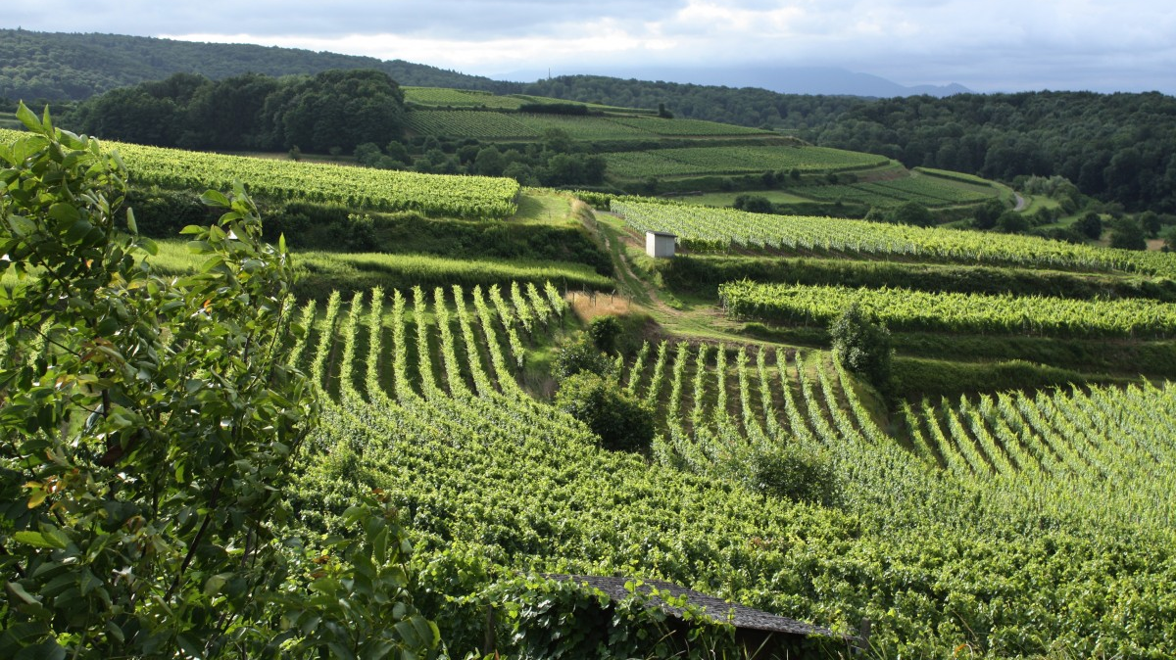
Bacchus Winery Case Study
Group 4:
Kyle Marlia-Conner Steve Stylin Ean Masoner Cuitlahuac Hernandez Mirajo Tesora

Slide 2

Introduction to Group #4
We’re all located in different time zones with different schedules.
Only two of us were located in the same time zone.
With coordination and playing to our strengths, we were able to complete the following:

Slide 3
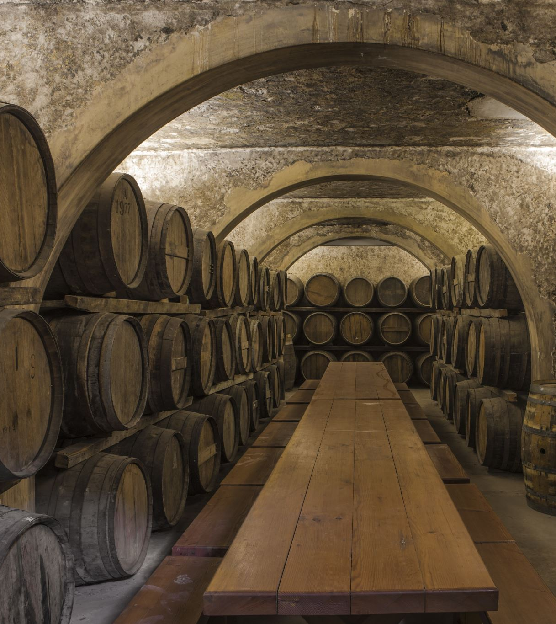
Bacchus Wine Overview
Stan and Davis Bacchus inherited the family winery from their father.
The Bacchus Winery case study aims to modernize operational methods.
The focus is on enhancing efficiency in:
Supply inventory tracking,
Enabling online distributor orders,
Shipment tracking,
Generate reports:
Assess supplier performance
Wine distribution
Employee work hours

Slide 4

How to Succeed:
As a group, we must show Stan and Davis that we can gather:
Supplier’s delivery time (and the difference between expected delivery and actual delivery).
The sales data of each type of wine and if they are selling as thought.
If not, which is the outlier, and, what distributors carry what wine?
How many hours each individual employee worked during the last four quarters.
With the following business rules, we believe we can accomplish this…

Slide 5
Business Rules - Employee Management
To accomplish this, we needed to make sure:
Each employee has a unique Employee ID.
Employees are categorized by their roles: Finance, Marketing, Production, and Distribution.
Each department has a head, and employees report to their respective department heads.
Employee work hours are tracked on a quarterly basis.

Slide 6
Business Rules - Wine Production
To accomplish this, we needed to make sure:
Bacchus Winery produces only four types of wine: Merlot, Cabernet, Chablis, and Chardonnay.
Each type of wine has a unique Wine ID and is associated with specific grape varieties grown on-site.

Slide 7
Business Rules - Supplier Management
To accomplish this, we needed to make sure:
There are three suppliers, each providing different components necessary for wine production and packaging.
Each supplier has a unique Supplier ID.
Suppliers are evaluated based on their delivery performance, precisely on-time delivery rates.
Monthly reports are generated to assess supplier performance.

Slide 8
Business Rules - Inventory Management
To accomplish this, we needed to make sure:
Inventory includes raw materials (grapes, bottles, corks, labels, boxes, vats, tubing) and finished products (wines).
Inventory levels are tracked in real-time to facilitate efficient ordering and supply management.
Stan and Davis are responsible for monitoring inventory levels and placing orders as needed.

Slide 9
Business Rules - Distribution and Sales Tracking
To accomplish this, we needed to make sure:
Distributors have unique Distributor IDs and can place orders online.
Each distributor is associated with specific wines they carry.
Shipment tracking is available for all orders placed by distributors.
Sales data is collected for each type of wine sold through various distributors.
Monthly sales reports are generated to analyze the performance of each wine type.
A wine is considered underperforming if it does not meet a predefined sales threshold.

Slide 10

Assumptions (make an…)
The winery operates on a monthly reporting cycle for inventory and sales.
All employees are full-time and work a standard number of hours each week.
The winery uses a centralized database to manage all information related to employees, suppliers, inventory, and sales.
Online ordering and tracking systems are implemented for both suppliers and distributors.

Slide 11
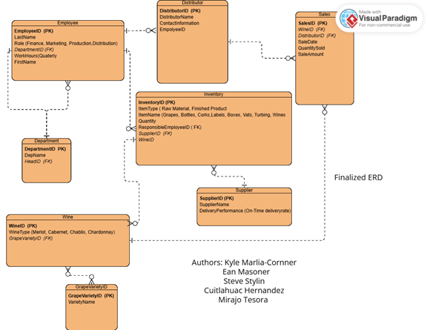
The Master, The Brain, The ERD
By analyzing the case study and utilizing the assumptions gathered, the group agreed upon the following ERD, as it will:
Help identify the distribution of supplies as well as carry a full inventory of what supplies are currently in stock.
Track the distribution of different kinds of wines and their salability compared to forecasted expectations.
Enable the ability for employees to log hours worked, as well as retrieve the information entered.

Slide 12
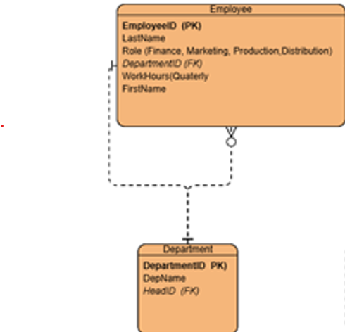
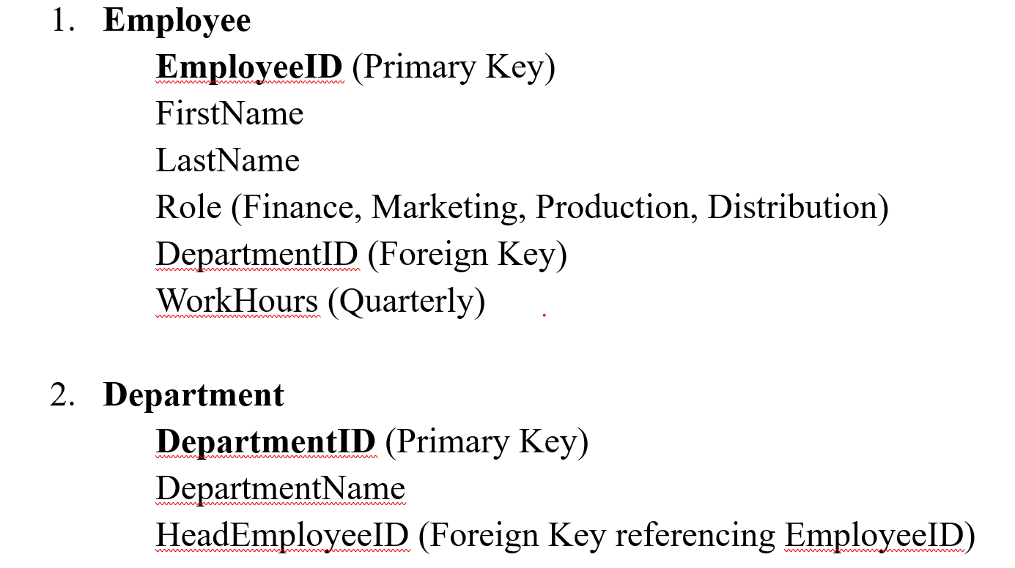
The Relationships Pt. 1
Employee to Department: One-to-Many (One department can have multiple employees, but each employee belongs to one department).
Department to Employee: One-to-One (Each department has one head).
Accomplished utilizing:

Slide 13
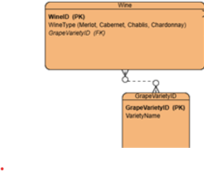
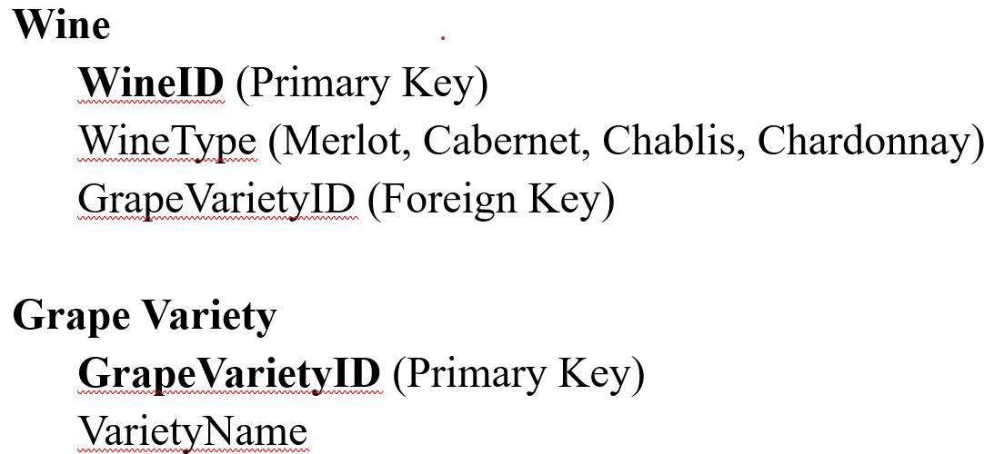
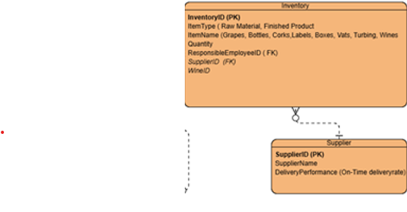
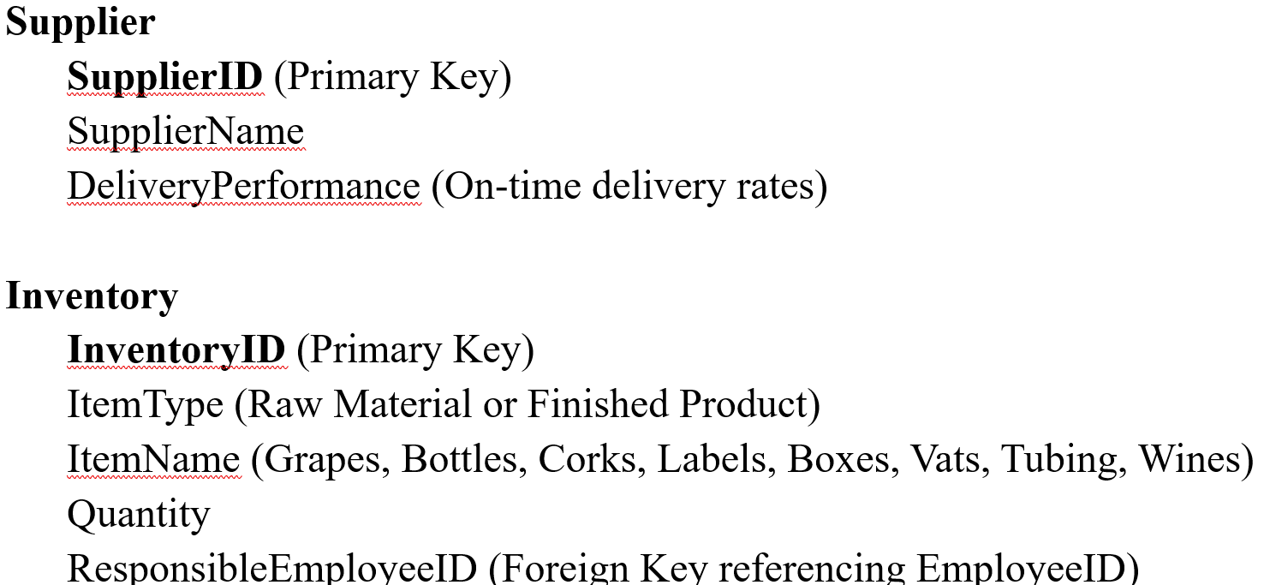
The Relationships Pt. 2
Wine to Grape Variety: Many-to-One (Each wine is associated with one grape variety, but a grape variety can be used for multiple wines).
Supplier to Inventory: One-to-Many (Each supplier can provide multiple inventory items).

Slide 14
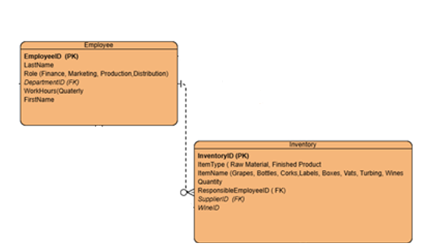
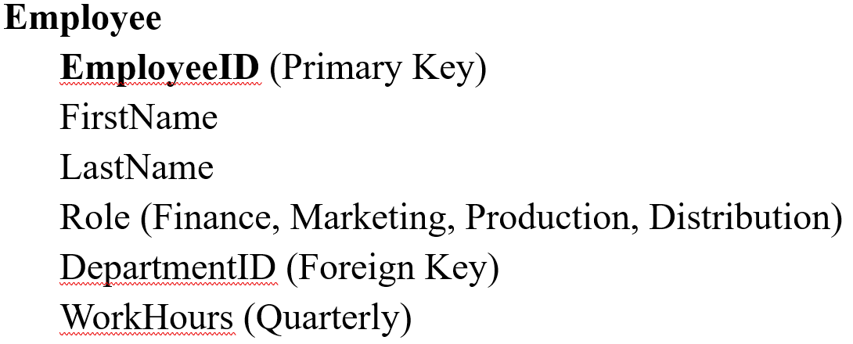
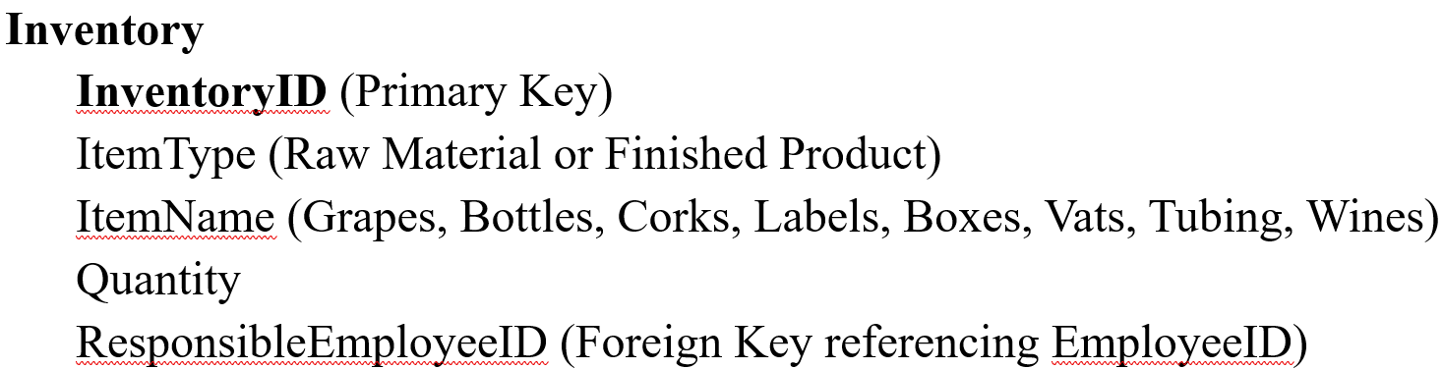
The Relationships Pt. 3
Inventory to Employee: Many-to-One (One employee monitors each inventory item).

Slide 15
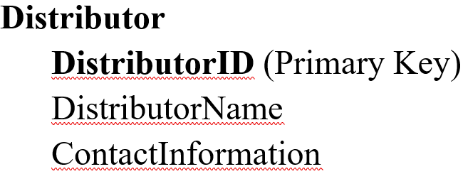
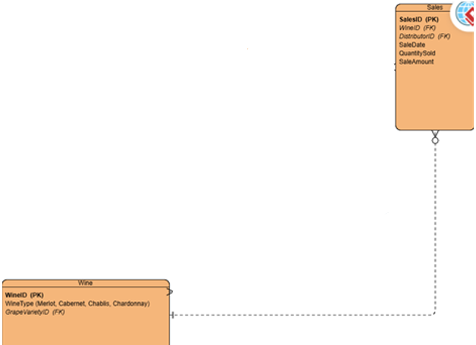
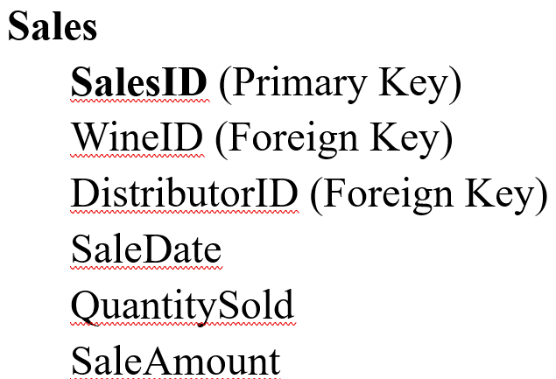
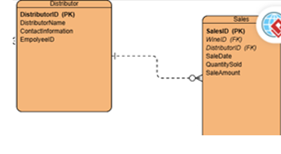
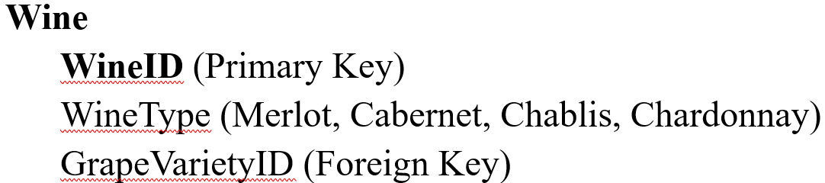
The Relationships Pt. 4
Distributor to Sales: One-to-Many (Each distributor can have multiple sales records).
Wine to Sales: One-to-Many (Each wine can have multiple sales records).

Slide 16
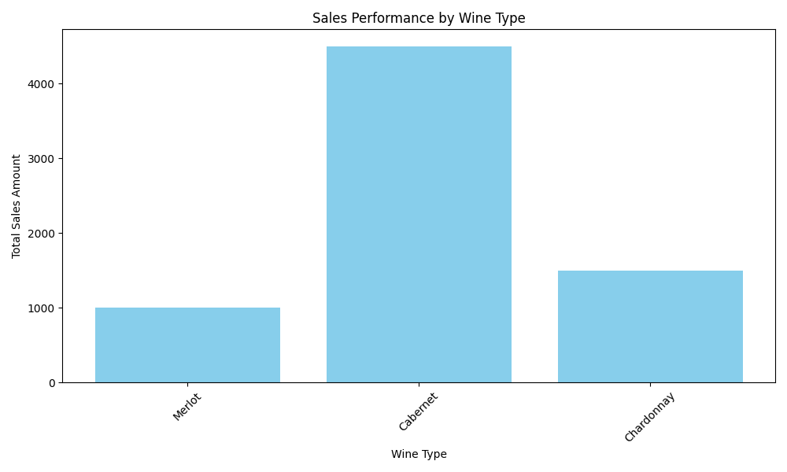
Generated Reports - Sales performance
This report was chosen to understand what products are selling to consumers.
After the report is generated, this would allow the winery to make decisions regarding their products such as removing the product from the list and making it seasonal or offering promotional deals to boost sales for lower generating products.
This example shows that Cabernet is the highest selling wine and allows the owners to look to different marketing decisions regarding the lower selling products

Slide 17
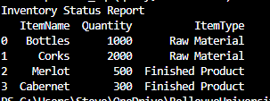
Generated Reports - Inventory
The inventory report allows us to see what materials we use in our process, and the current stock of each material.
This report would also allow us to decide what point we should begin reordering our products.
Looking at the generated report this shows that we currently have 1,000 bottles, and the owners could consider this to be a low stock and create the ordering point at 1,500 bottles.

Slide 18
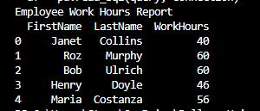
Generated Reports – Worked Hours
The worked hours report allows us to see how many hours our employees are working to accurately keep track of payroll costs.
This example shows us that Roz and Bob worked 60 hours during the pay period, and this would allow us to see if we need to hire more employees to prevent others from working to much.

Slide 19
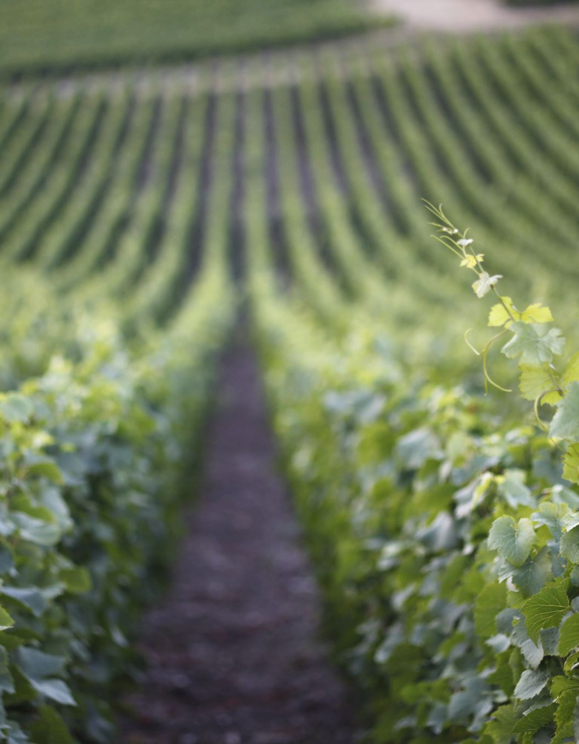
Conclusion
The operational analysis of Bacchus Winery reveals a well-organized structure that effectively manages employee roles, wine production, supplier partnerships, inventory control, and sales tracking.
The established business rules not only provide clarity and efficiency in day-to-day operations
But also facilitate strategic insights through consistent reporting and performance evaluations.
The assumptions made further reinforce the reliability of the ERD presented in this case study, highlighting the winery's commitment to leveraging a centralized database and modernized systems for order and inventory management.
Through this detailed exploration, Bacchus Winery can be positioned to optimize its processes, ensure quality in production, and enhance profitability in a competitive market.

Slide 20

FIN

